Slide 1
Introduction to Operating Systems
H M Ikram kays

Slide 2
What is an Operating System?
A software layer that manages hardware and software resources.
Acts as an intermediary between users and hardware.
Provides a stable, efficient environment for applications to run.

Slide 3
Main Functions of an OS
Resource Management: Controls CPU, memory, and I/O devices.
Process Management: Handles program execution and multitasking.
File Management: Organizes data and provides access methods.
User Interface: Provides command-line or graphical interfaces.

Slide 4
Evolution of Operating Systems
Generation | Type | Description
1st | Batch Systems | Jobs run one at a time, no interaction.
2nd | Time-Sharing Systems | Multiple users share CPU time.
3rd | Distributed Systems | Computers linked over a network.
4th | Mobile/Embedded OS | Used in phones, IoT devices, etc.

Slide 5
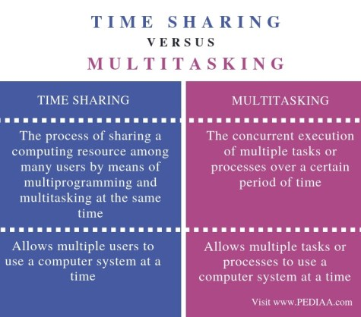
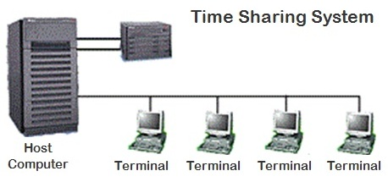

Slide 6
Layers of a Computer System
Hardware – CPU, memory, I/O devices
Operating System – Controls and coordinates hardware use
System Programs – Utilities and tools for users: file managers, compilers, linkers, assemblers, debuggers, and command-line tools
Application Programs – Software that performs user tasks: MS word, pdf reader

Slide 7
Operating Modes
User Mode: Limited privileges; runs user applications.
Kernel Mode: Full control; runs OS code.

Slide 8
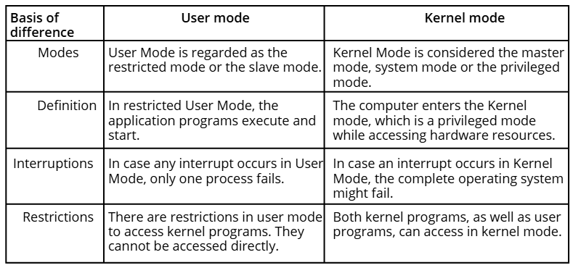
User vs Kernel

Slide 9
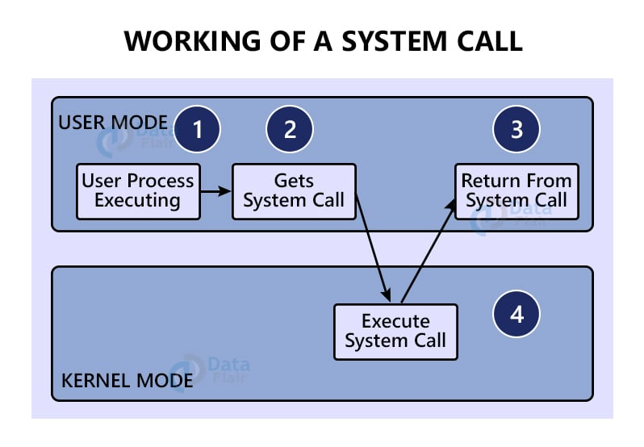
System call

Slide 10
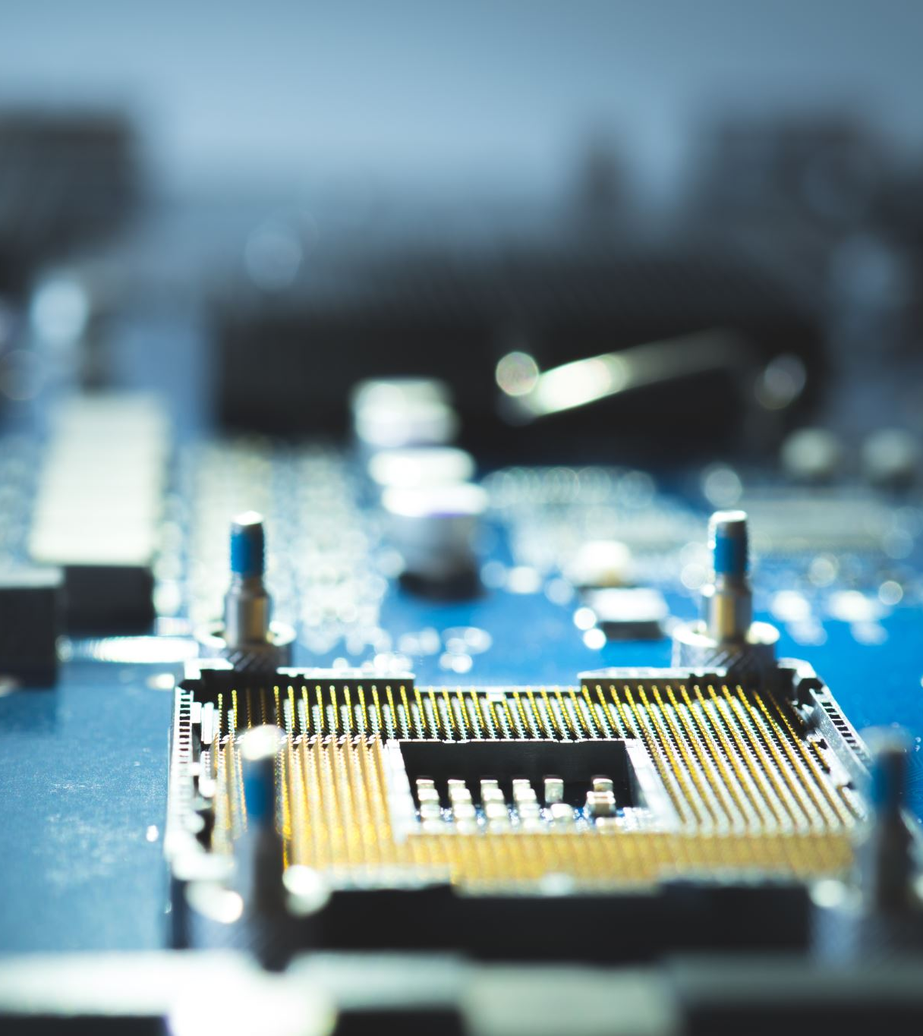
Example
A user program calls a library function (e.g., printf() in C)
The function internally triggers a system call (e.g., write() syscall)
the CPU switches temporarily from user mode → kernel mode.
The kernel executes the requested service.
Control returns to the user program.

Slide 11
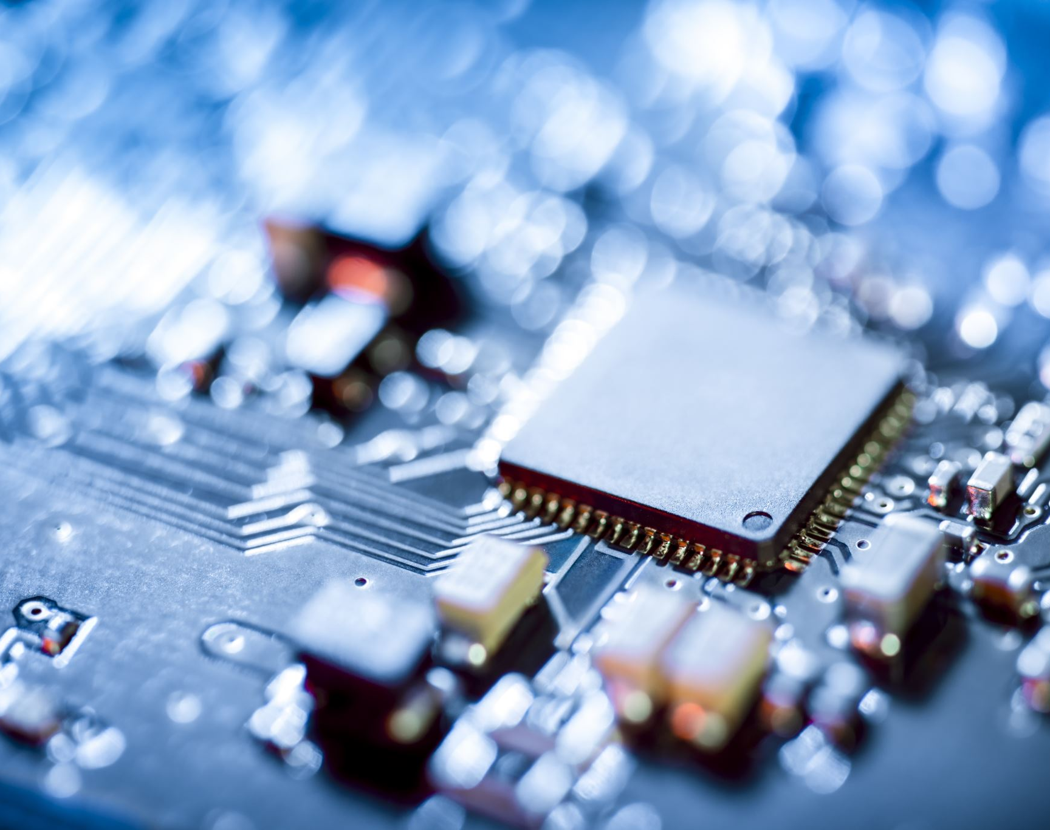
Multiprocessor and Multicore Systems

Slide 12
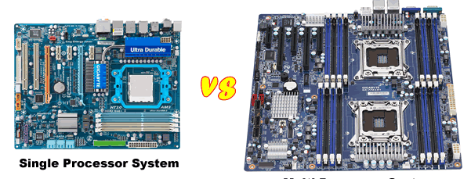
Multiprocessor Systems
Two or more separate CPUs in one computer.
Shared memory and devices.
Used in servers and high-performance systems.
Advantages: High throughput, reliability.
Drawbacks: Expensive and complex to manage.

Slide 13
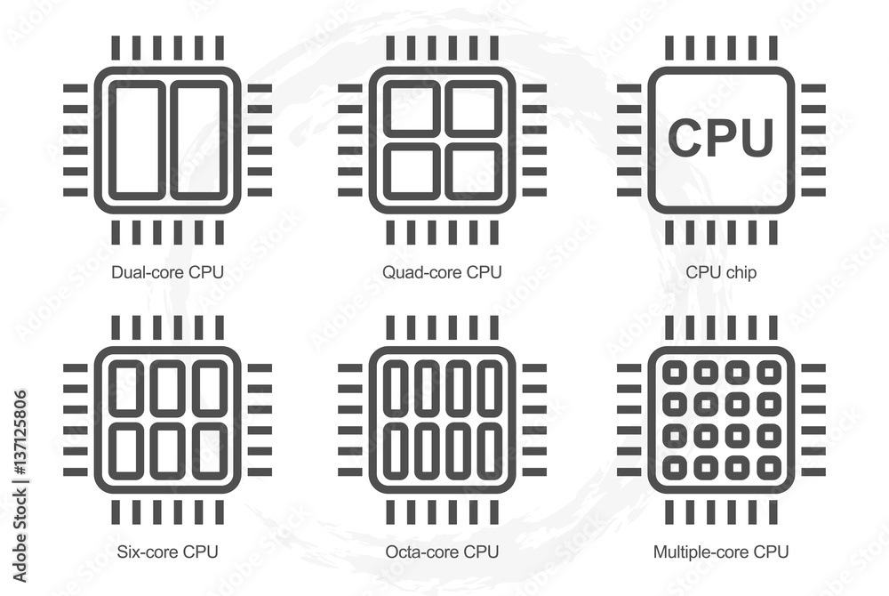
Multicore Systems
Multiple processing cores within one CPU chip.
Each core can handle tasks independently.
Found in most modern PCs, laptops, and smartphones.
Advantages: Energy efficient, cost-effective, compact design.

Slide 14
Comparison Table
Feature | Multiprocessor | Multicore
Physical CPUs | Multiple | Single
Cores | Each CPU may have several | Multiple on one chip
Communication | Between CPUs | Between cores
Cost | High | Lower
Example | Dual-CPU Server | Intel Core i5 (8-core, 12-thread)

Slide 15
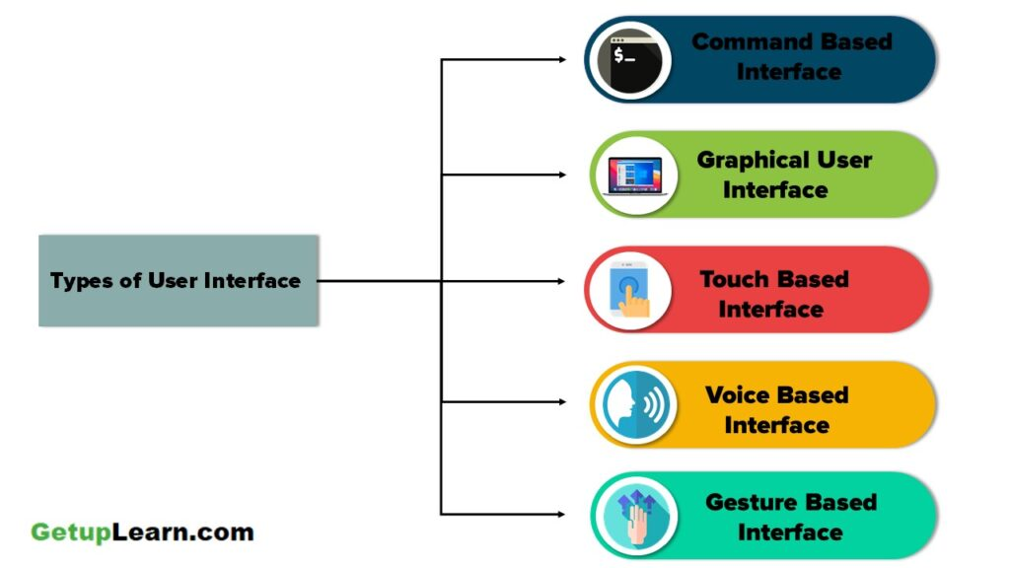
What is an Operating System Interface?
Two major types:
Command-Line Interface (CLI) – e.g., Bash, PowerShell.
Graphical User Interface (GUI) – e.g., Windows, GNOME.

Slide 16
Operating System Services
Program Execution – load and run programs.
I/O Operations – read/write files and devices.
File System Manipulation – create, delete, read, write, search files.
Communication – exchange data between processes.
Error Detection – handle and report errors.
Resource Allocation – CPU, memory, I/O devices.
Accounting & Protection – track usage, ensure safe access.

